Slide 1

Ola Cabs: A Balanced Scorecard Approach for Enhancing Company Performance
MSBA 301 Final Project
Sylvester Ronith Reagan

Slide 2
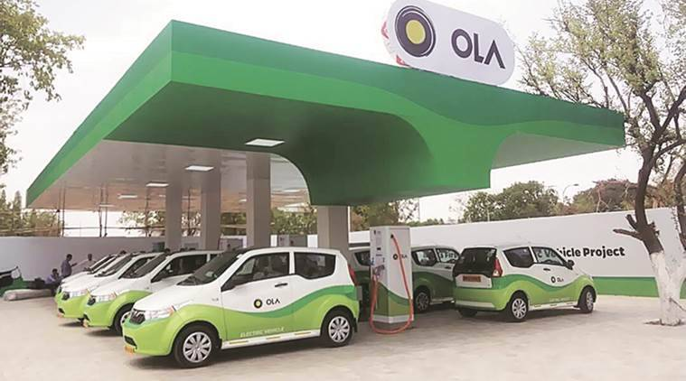

Slide 3
1: Executive Summary
Content:
Implementing a Balanced Scorecard (BSC) approach for Ola Cabs to align strategic goals with operational performance.
The project focuses on enhancing performance across Financial, Customer, Internal Process, and Learning & Growth perspectives.
Objective: To drive sustained growth and competitiveness through actionable KPIs.
Visuals:
High-level summary boxes or bullet points.
Icons representing the four perspectives (Financial, Customer, Internal Process, Learning & Growth).

Slide 4
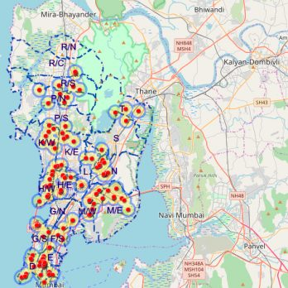
2: Company Overview
Content:
Mission: To build mobility for a billion people, offering affordable, reliable, and convenient rides.
Vision: To be the number one transport choice globally.
History: Founded in 2010, Ola has grown to be a leading ride-hailing company in India, operating in over 250 cities.

Slide 5
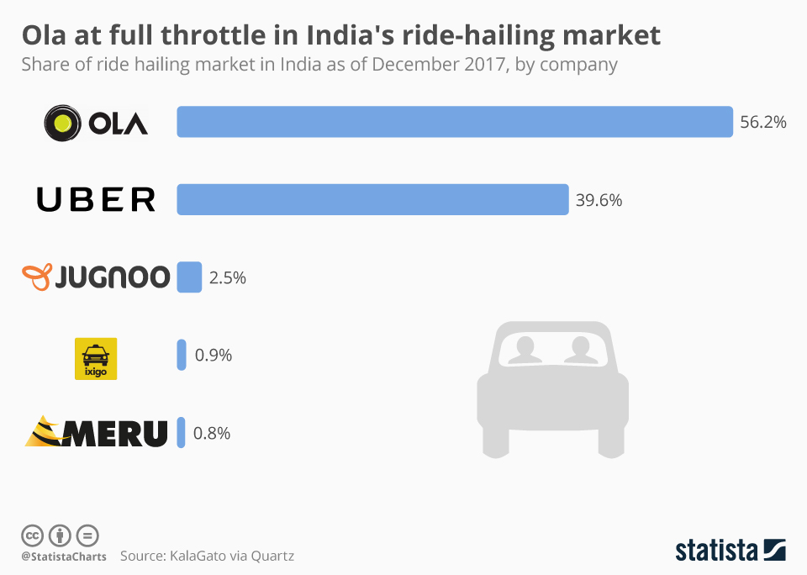
3: Current Performance
Content:
Financial Performance:
Challenges with operational costs, pricing pressures, and competition, leading to reduced profitability.
Market Performance:
56% market share in India, with significant competition from Uber and other local players.
Customer Satisfaction:
Issues with service duration, pricing, driver behavior, and app availability affecting customer satisfaction.

Slide 6
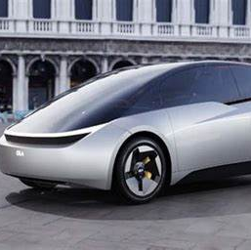
4: Company Strategies
Content:
Expansion Strategy:
Focus on increasing electric vehicles (EVs) and entering new international markets.
Technology Integration:
Enhancing app capabilities using AI for better user experience and operational efficiency.
Sustainability:
Initiatives to reduce carbon emissions through EVs and promoting ridesharing.

Slide 7
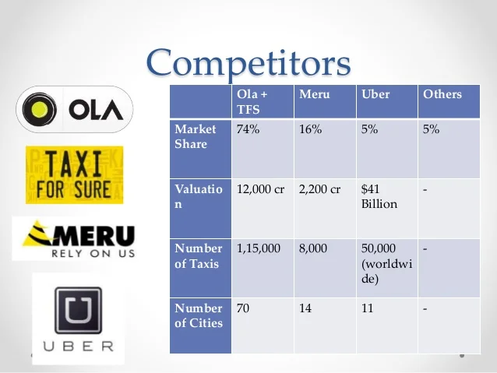
5: Market & Competitor Analysis
Competitors:
Uber, Rapido, and local taxi companies.
Ola’s competitive edge: Strong local operations, diversified services, cost-efficient pricing.
Market Trends:
Growing demand for shared mobility solutions and electric vehicles.

Slide 8
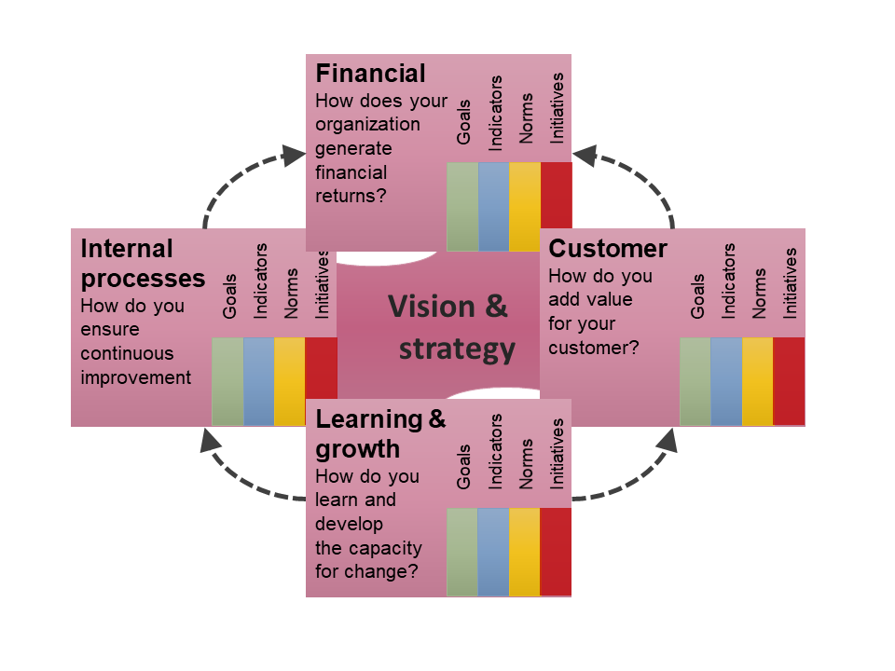
6: BSC Framework & KPI Process
Balanced Scorecard (BSC) Framework:
Aligns Ola's strategic objectives with measurable performance indicators across four perspectives.
Key Performance Indicators (KPIs):
Financial Perspective: Revenue Growth Rate, Operating Margin.
Customer Perspective: Retention Rate, Customer Satisfaction Score.
Internal Processes: Ride Fulfillment Rate, Efficiency of Driver Onboarding.
Learning & Growth: Employee Training Hours, Innovation Index.

Slide 9
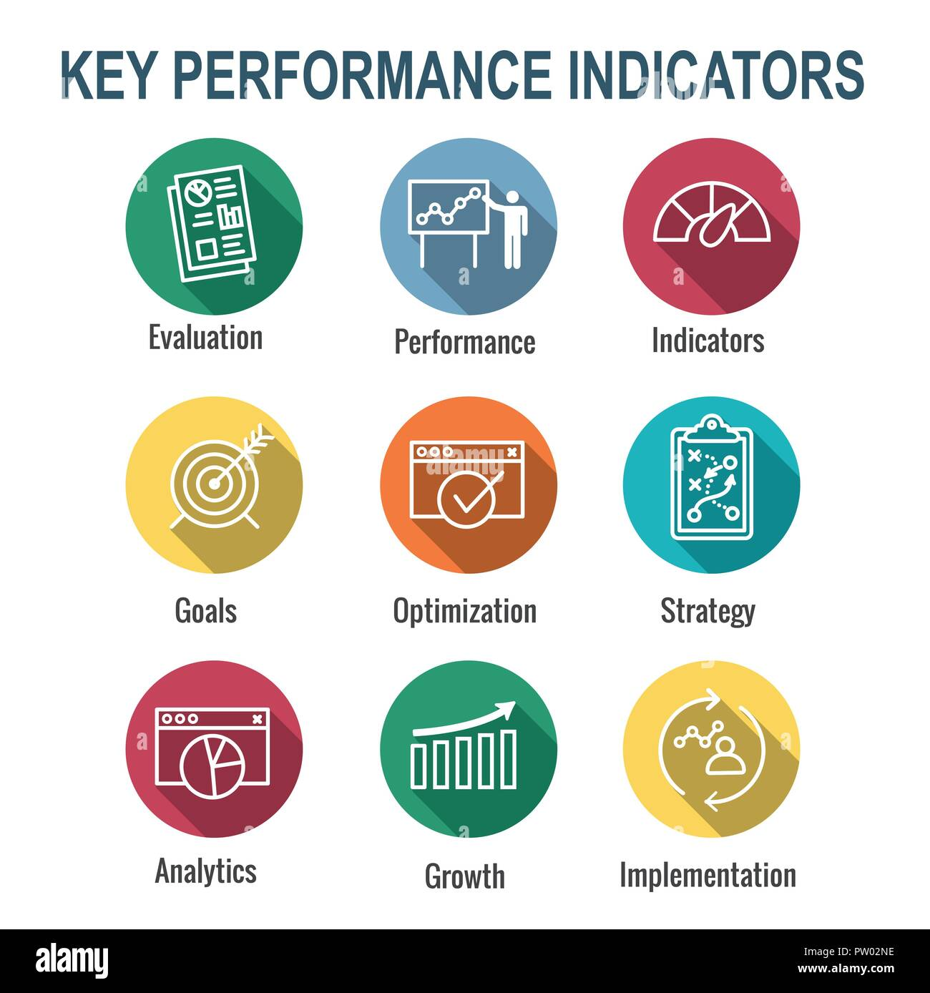
7: Selected Performance Measures
Composite Indicators:
Customer Satisfaction Index, combining metrics like retention rate, ride ratings, and complaint resolution time.
Targets & Thresholds:
Revenue Growth: 15% YoY.
Customer Satisfaction: >85%.
Employee Satisfaction: 90%.

Slide 10
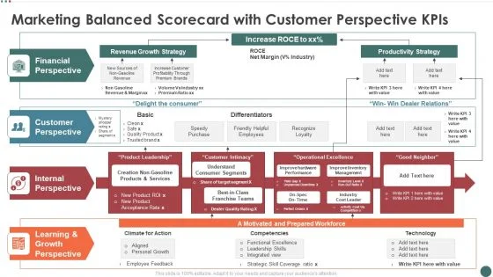
8: Mock-Up Balanced Scorecard
A mock-up of Ola’s Balanced Scorecard, showing how performance is tracked across the four perspectives.

Slide 11

9: Additional Scorecard Elements
Measurement & Reporting:
Revenue Growth, Net Income, ROI, Customer Satisfaction, Market Share, Ride Fulfillment, Employee Turnover, App Uptime.
Concealment Prevention:
Automated systems, internal audits, third-party verification to ensure transparency and accuracy in reporting.

Slide 12
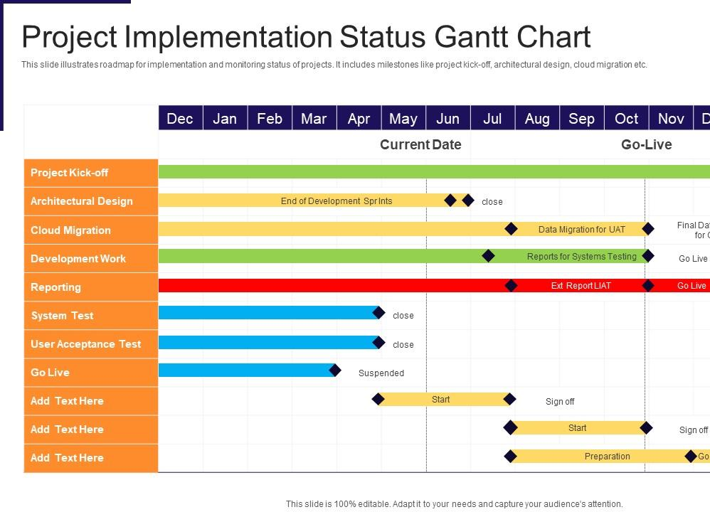
10: Implementation & Monitoring
Proposed Automation Tool:
Tools like Zoho Analytics or Tableau for real-time performance tracking.
Data Collection & Monitoring Plan:
Weekly data collection, monthly performance analysis.
Assigned responsibility to department heads and a central oversight team.

Slide 13
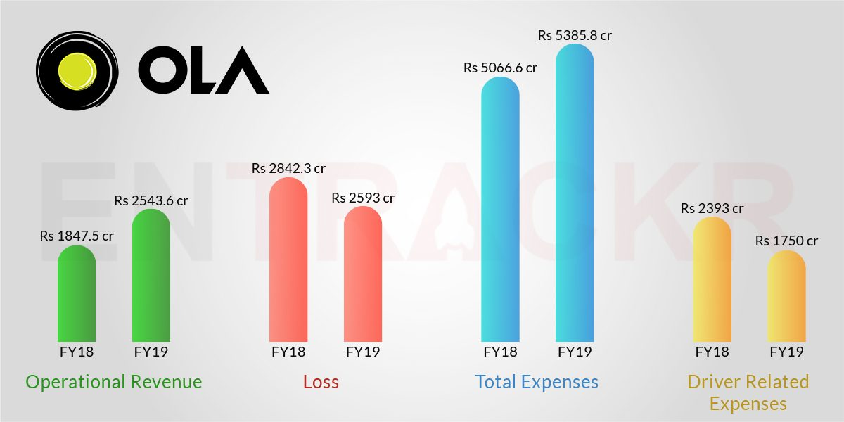
11: Plan of Analysis
Data Analysis:
Utilizing trend analysis, benchmarking against competitors, and scenario planning.
Performance Improvement Plan:
Recommendations for continuous improvement and regular performance reviews.

Slide 14

12: Conclusion
Summary:
The Balanced Scorecard approach offers a comprehensive strategy for Ola to align its goals and improve performance across all key areas.
The focus on technology, sustainability, and market expansion are crucial for maintaining a competitive advantage.
Request for Approval:
Highlight the potential benefits of the PM plan and formally request approval to proceed with its implementation.

Slide 15
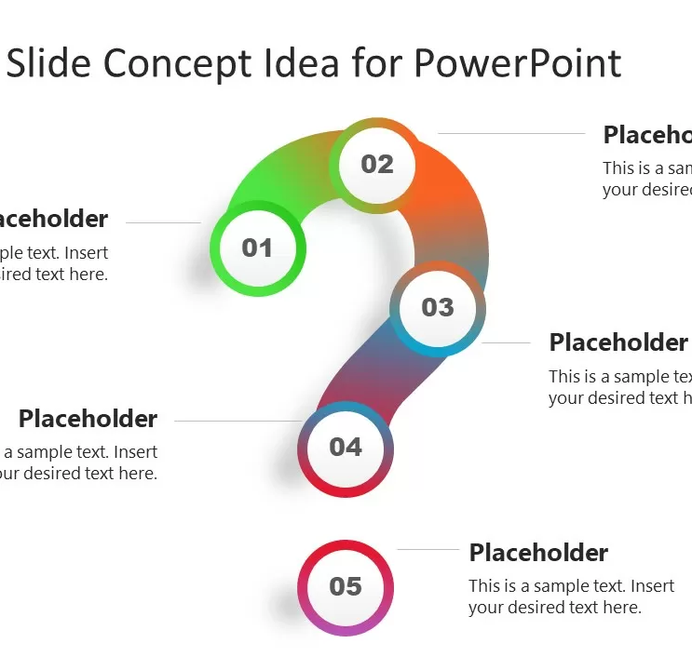
13: Questions
Invite questions from the audience.
Be prepared to address specific questions about the BSC implementation or Ola’s strategic goals.

Slide 16


